Slide 1

Building an R-Ladies community during the COVID-19 pandemic
June 21, 2022
10:45 am - 12:00 pm CDT
Speakers: Shel Kariuki & Njoki Njuki

Slide 2

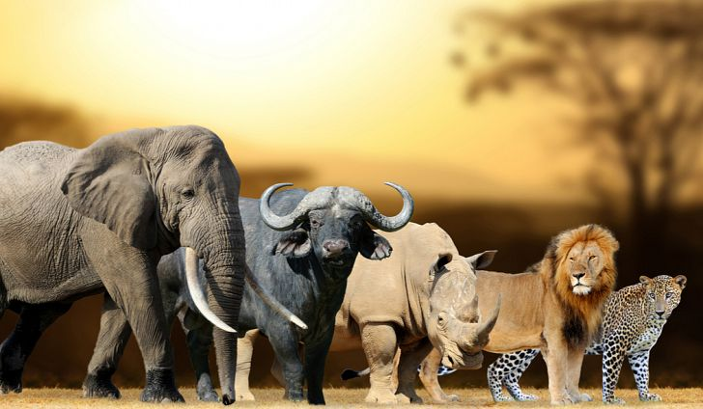
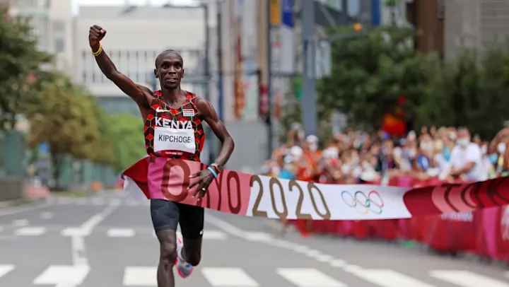

Slide 3
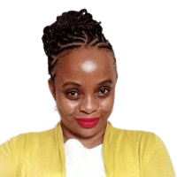
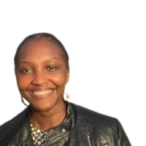
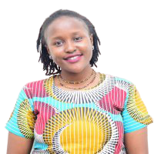
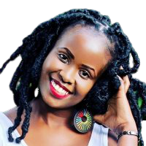
How did we meet…
Shel Kariuki
Data Analytics Consultant
Maggie was an R-Ladies curator on the same week that #NairobiR was being launched
Attended a data science workshop
Margaret Wanjiru
Risk Analyst
Njoki Njuki
Research Assistant
(Data Scientist)
(The University of Manchester)
Faith Musili
Senior Data Analyst

Slide 4
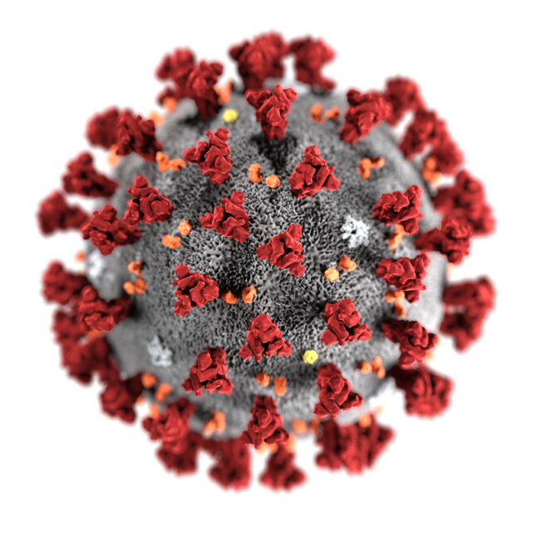
But Covid hit …

Slide 5

Our First Call!!
Margaret Wanjiru
Risk Analyst
Njoki Njuki
Research Assistant
(Data Scientist)
(The University of Manchester)
Faith Musili
Senior Data Analyst

Slide 6
Social media
(meetup, twitter, GitHub, youtube)
Communicating with participants
Njoki Njuki
Lead Organizer
Faith Musili
Margaret Wanjiru
Shel Kariuki
Co-organizer
Co-organizer
Co-organizer
Communicating with speakers
Posters + Social Media
A little bit of everything

Slide 7
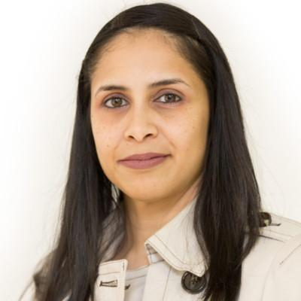
… Looking for mentors
Collaboration between RUGs and R-Ladies
Participation of men in the R-Ladies activities
Division of tasks
Achievements of R-Ladies
Support from the R-Ladies global
Motivate the ladies to join and stay on R programming
Vebashini Naidoo
R-Ladies Johannesburg organiser

Slide 8
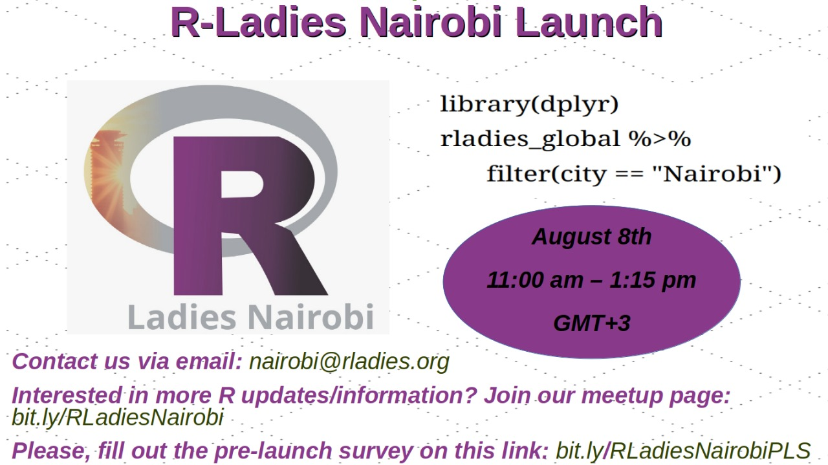
Organising the Launch event
Recognition by R-Ladies Global, receive details such as CoC, email address, meetup page
Reached out to the R-Ladies Global
( info@rladies.org)
Pre-launch survey
Set a Launch date (August 8, 2020)
Advertise on social media (Twitter; LinkedIn)
For more info → https://rladies.org/

Slide 9
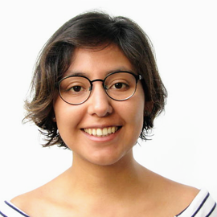
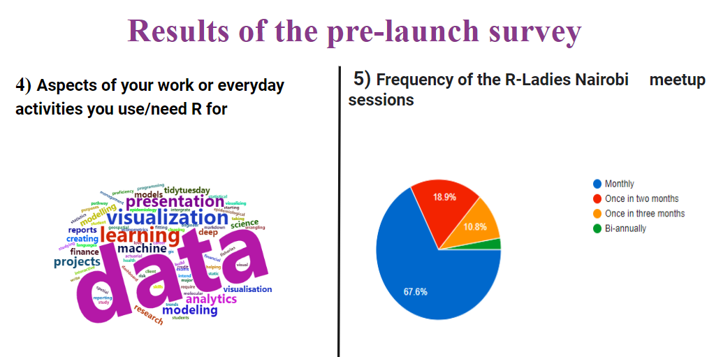
…and we finally launched
22 members joined
R-Ladies Global mission and vision
Brief history of R-Ladies
Informed members about the CoC to ensure harassment free in all our spaces
Results of the pre-launch survey
Vebashini Naidoo
Paloma Rojas - Saunero
R-Ladies Johannesburg organiser
R-Ladies Rotterdam organiser

Slide 10
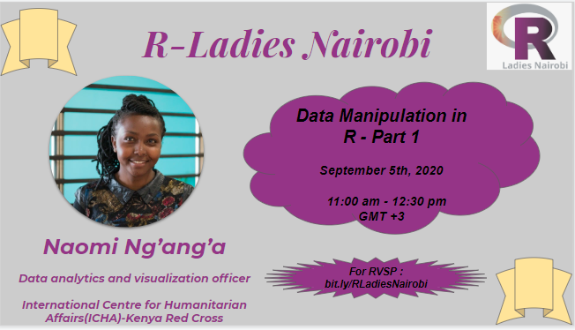
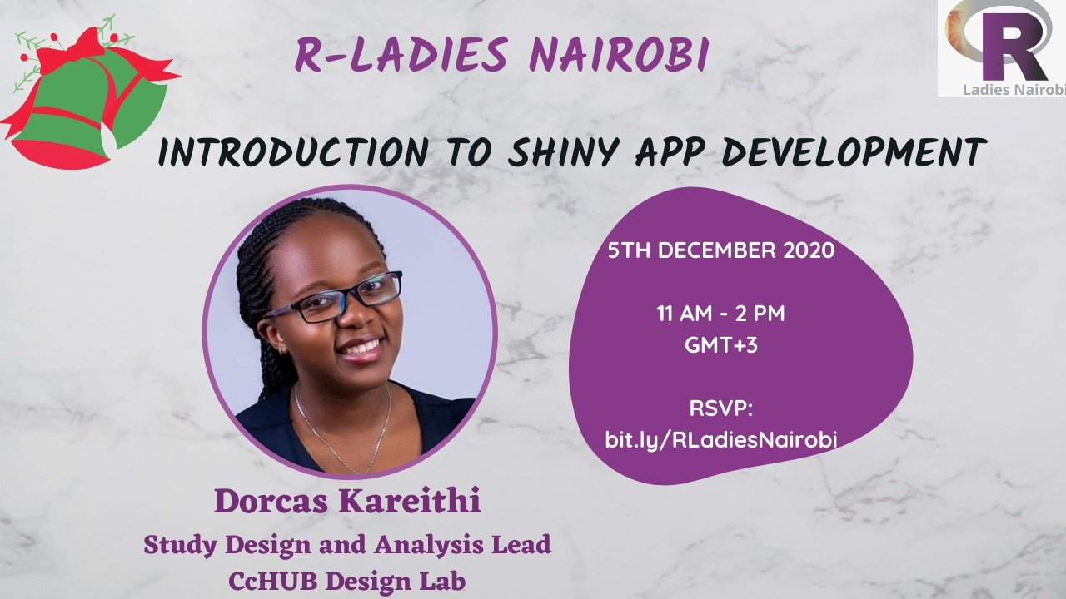
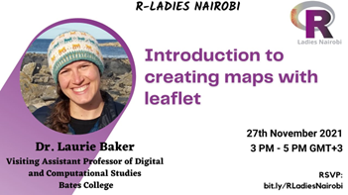
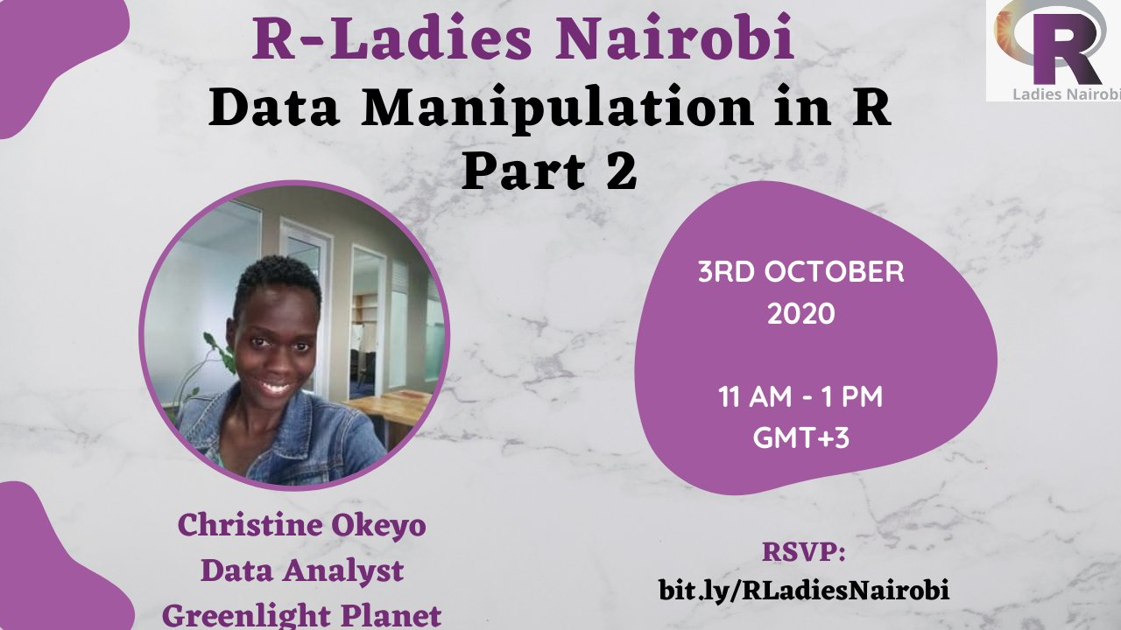
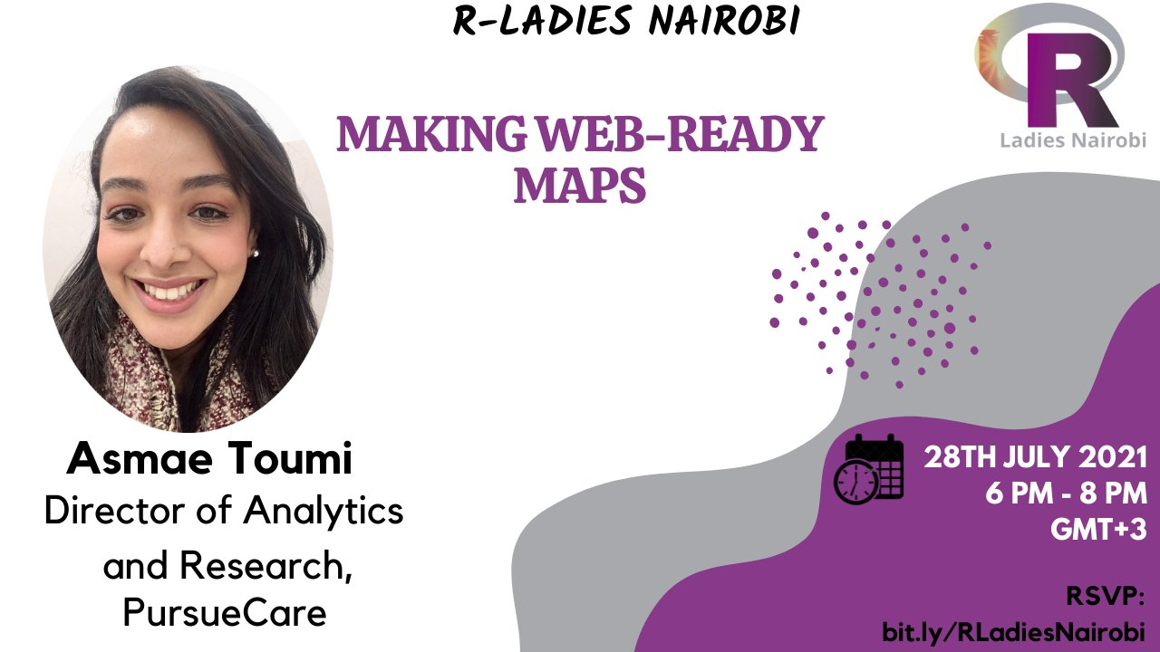
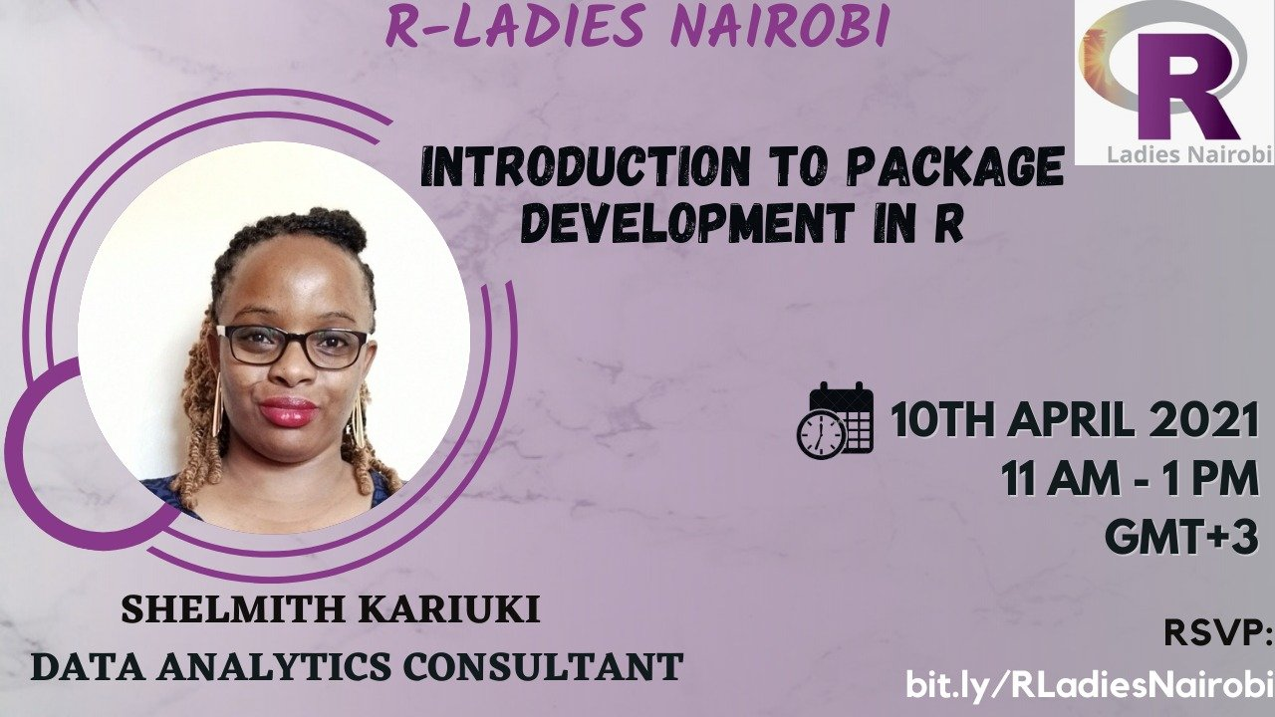
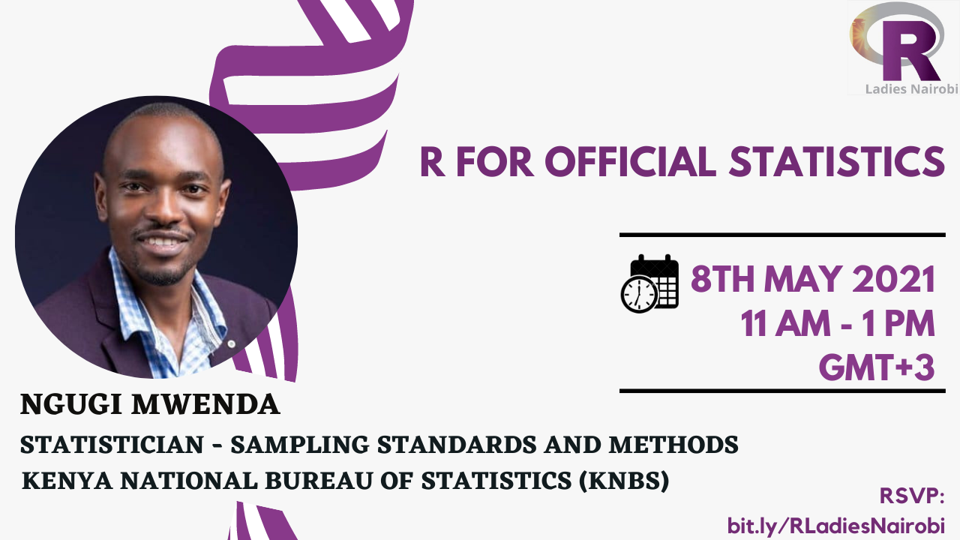
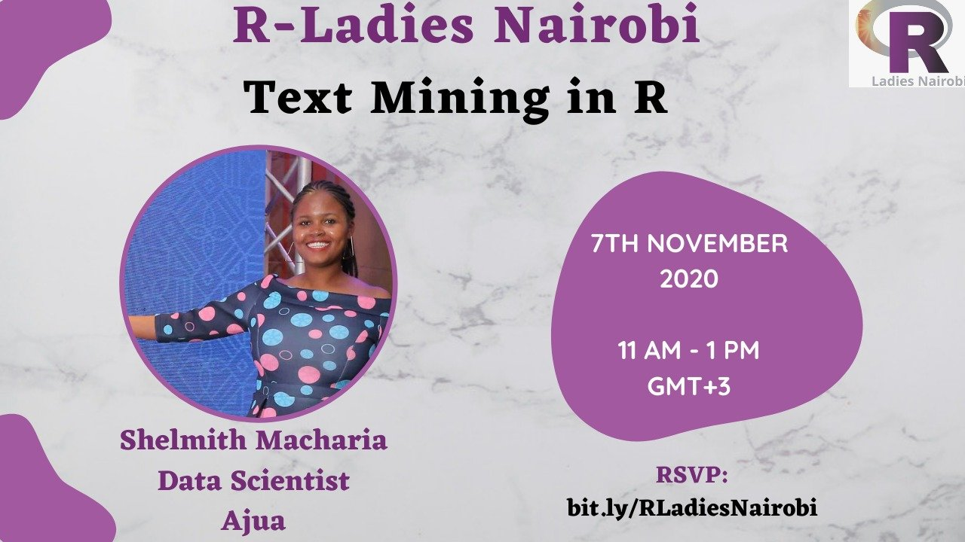
Past Events…
Notes:
We held 10 events including the launch:
data manipulation parts 1 and 2;
text mining
introduction to shiny app development
networks and graphs for Biology in R
intro to package development;
R for official statistics; working with databases;
making web-ready maps

Slide 11
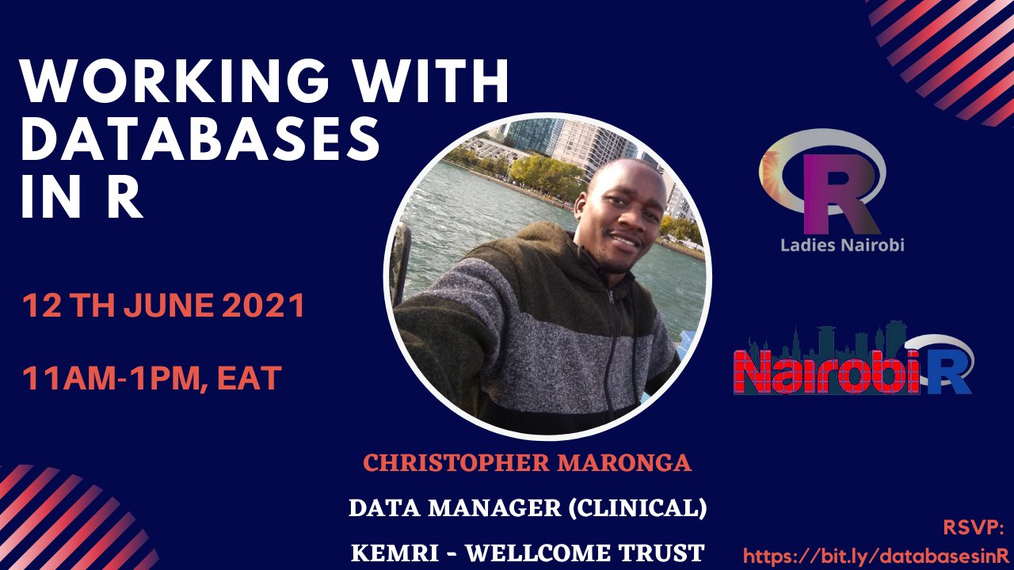
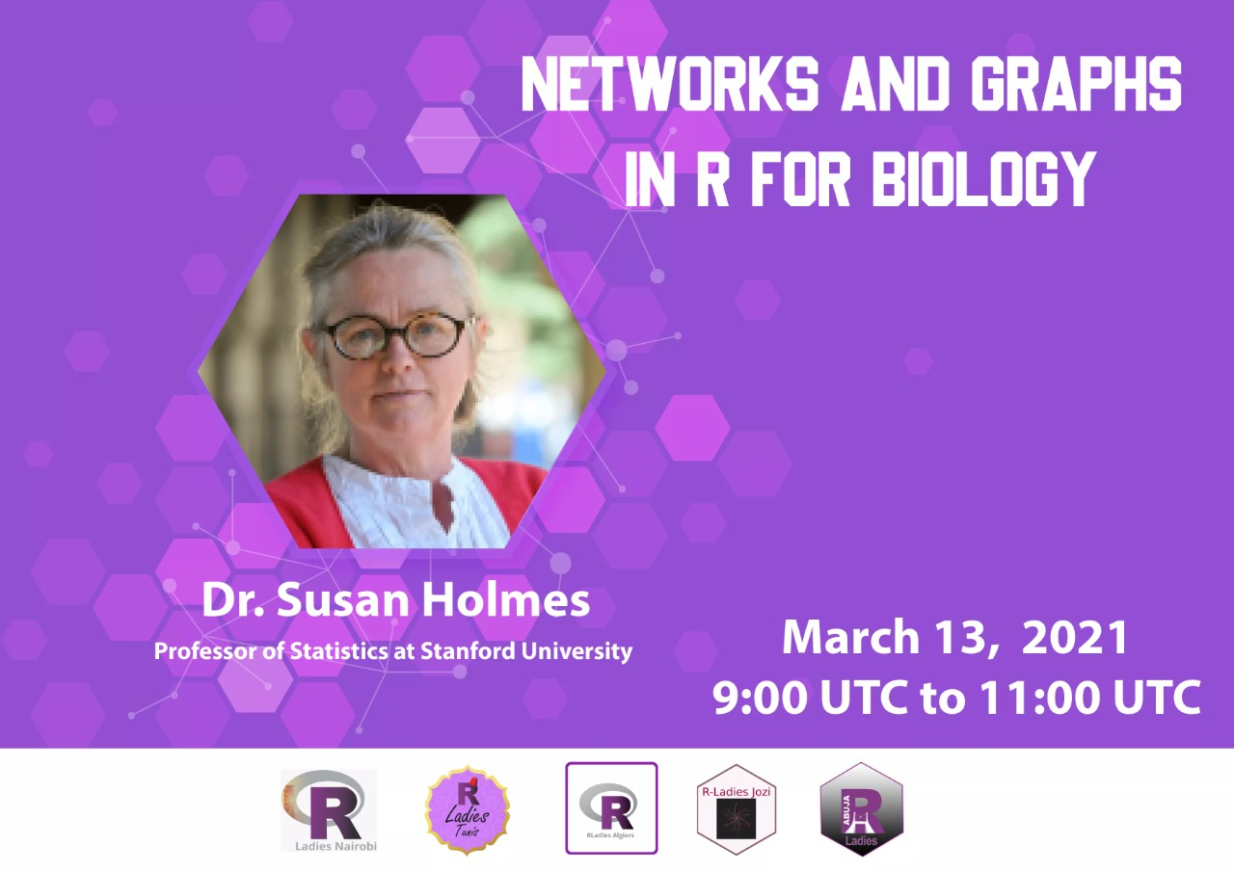
Collaborations with other groups…
Notes:
We have collaborated with other R-Ladies chapters in Africa and Nairobi R User Group for events.

Slide 12
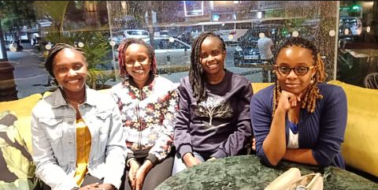

Slide 13


satRday Nairobi Conference 2021
#satRdayNairobi2021

Slide 14
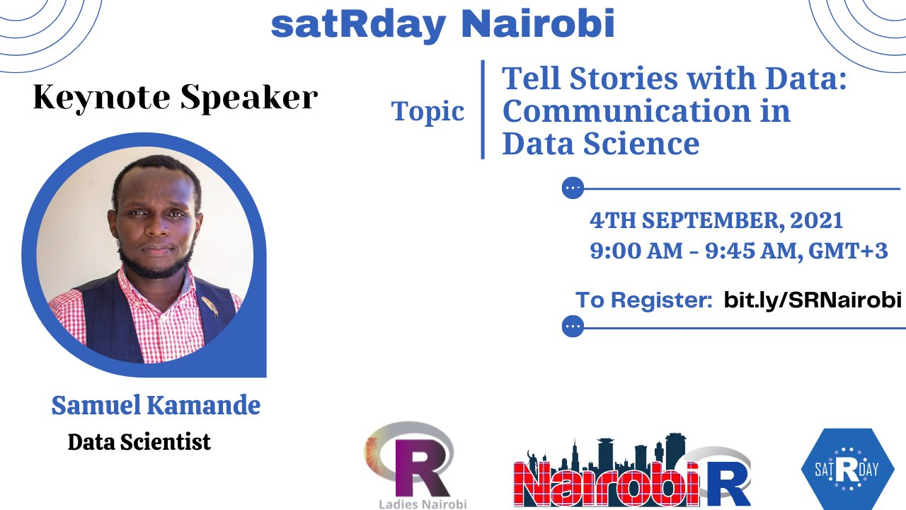
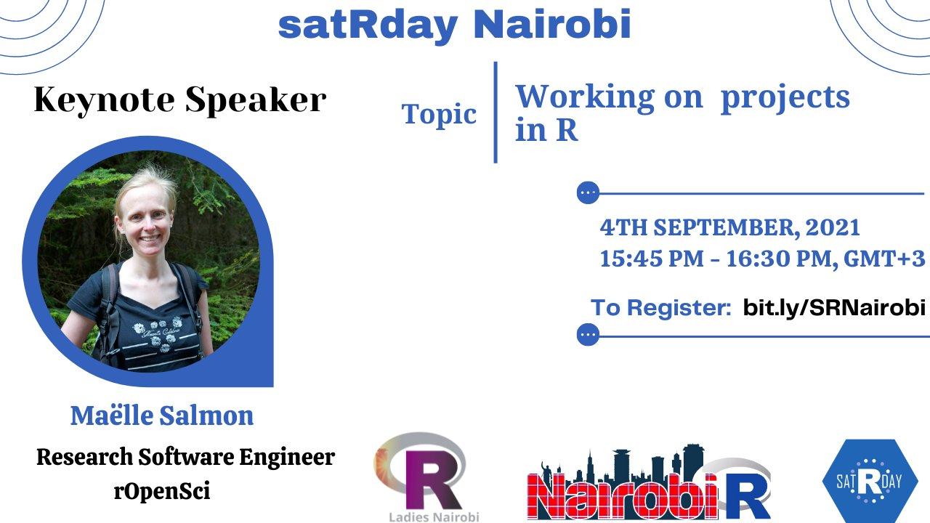
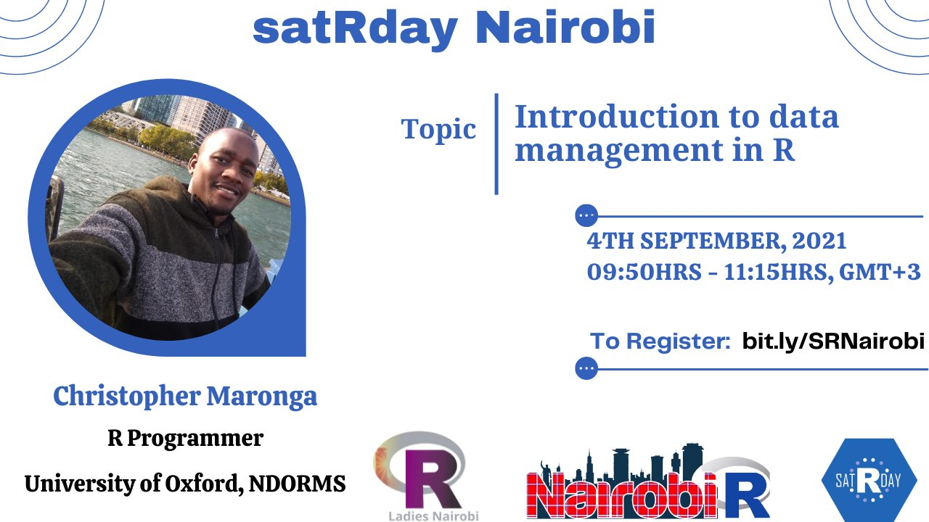
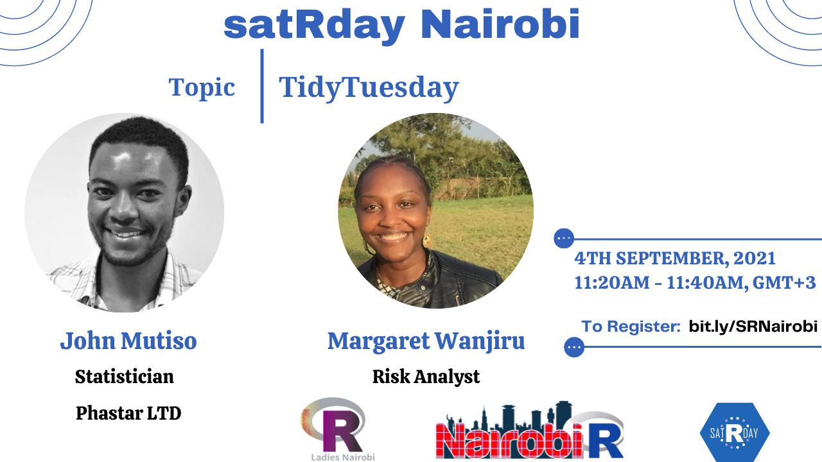
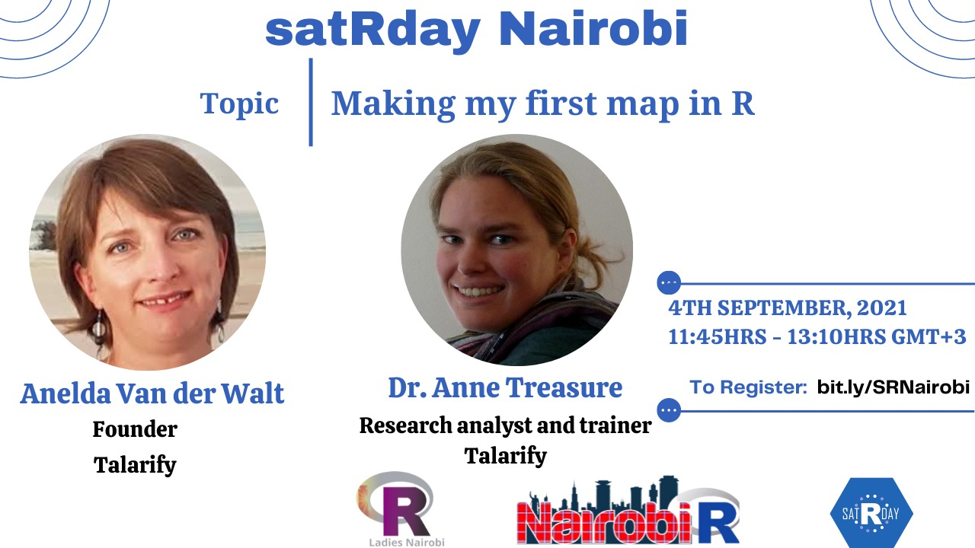
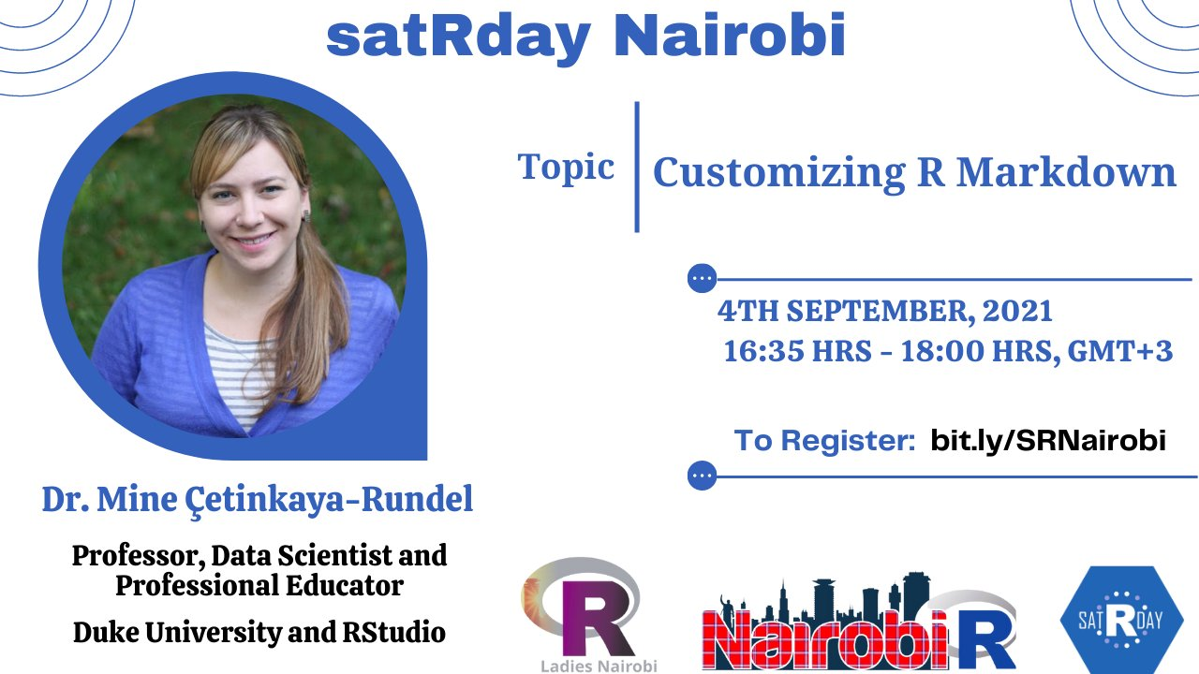
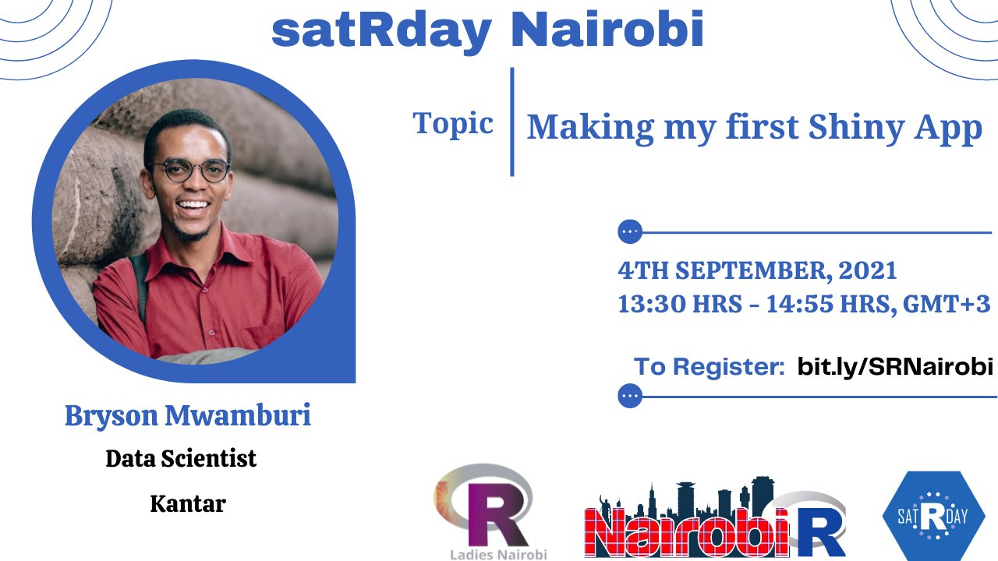
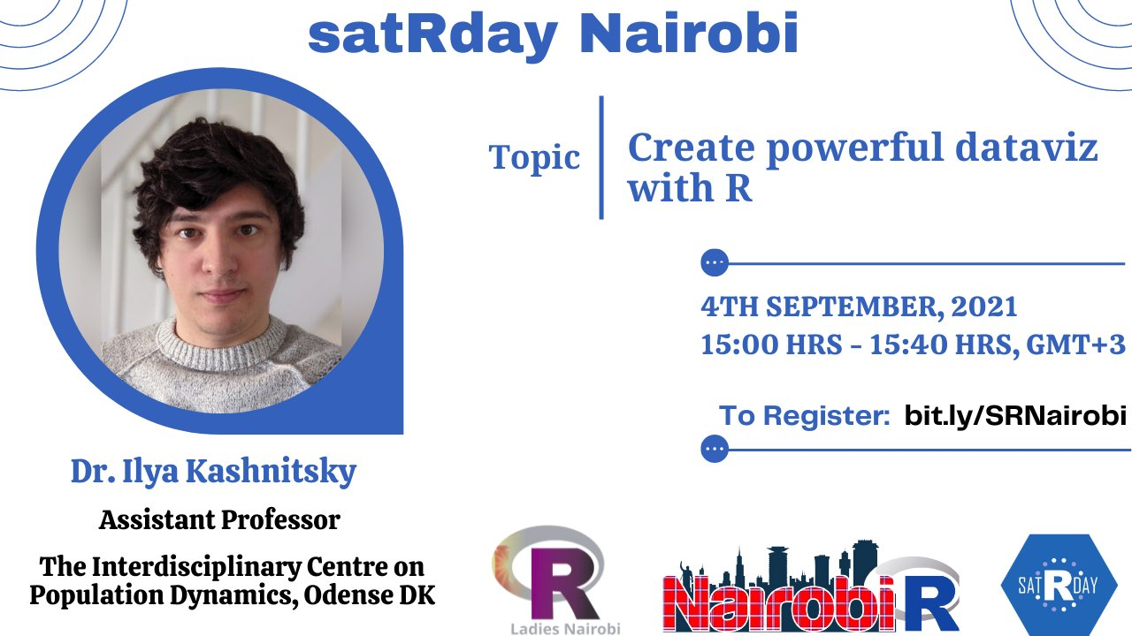
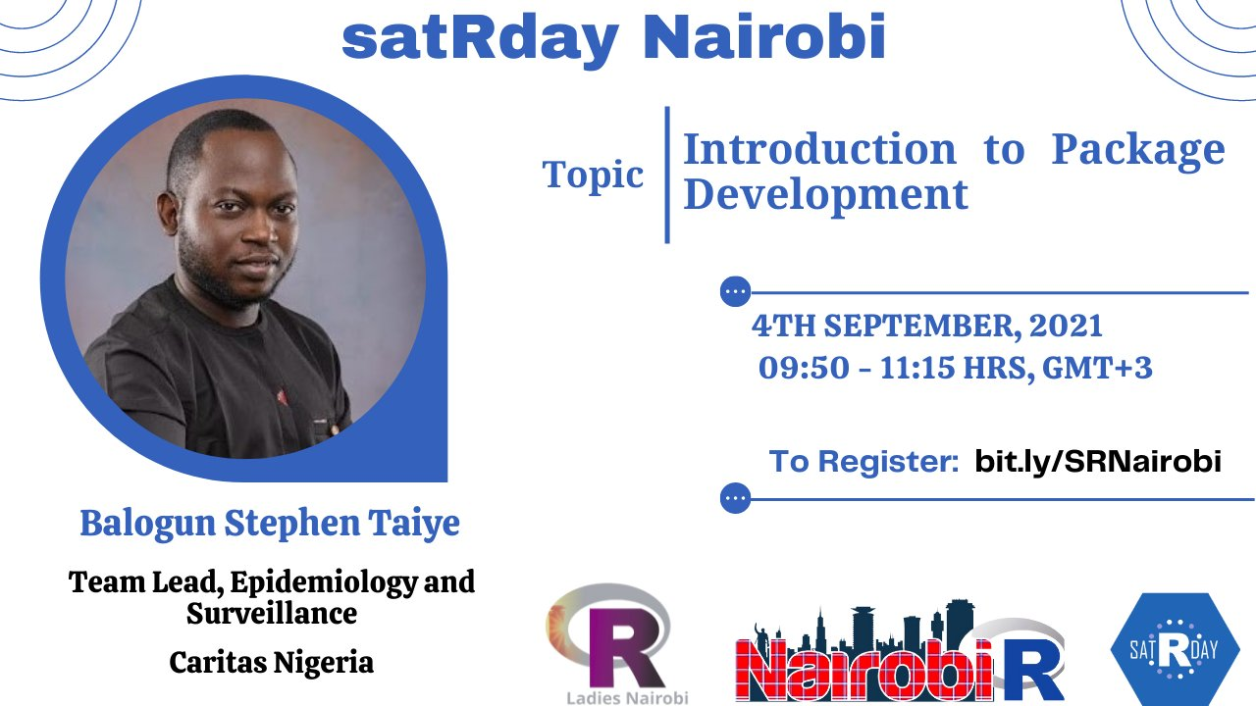
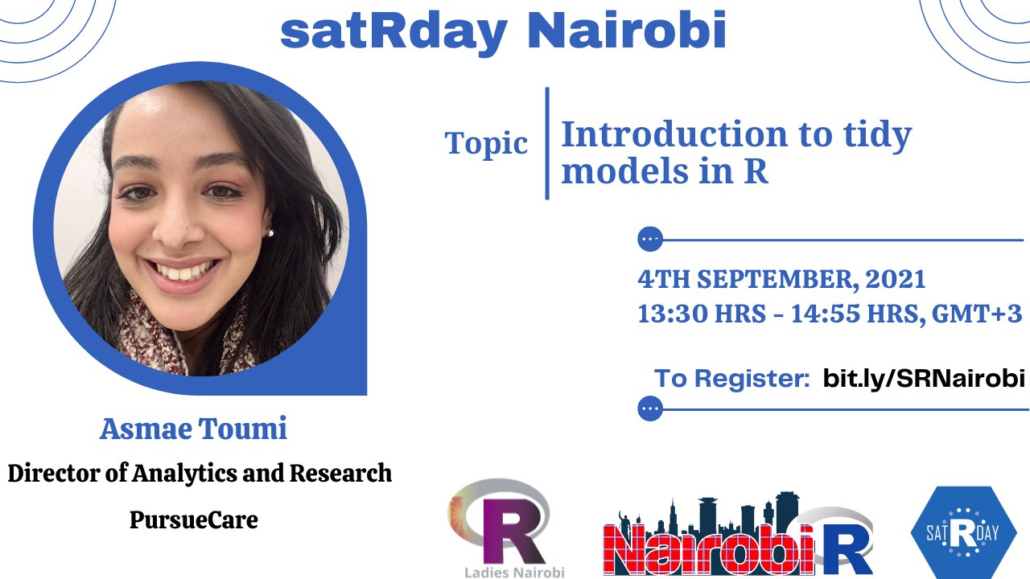

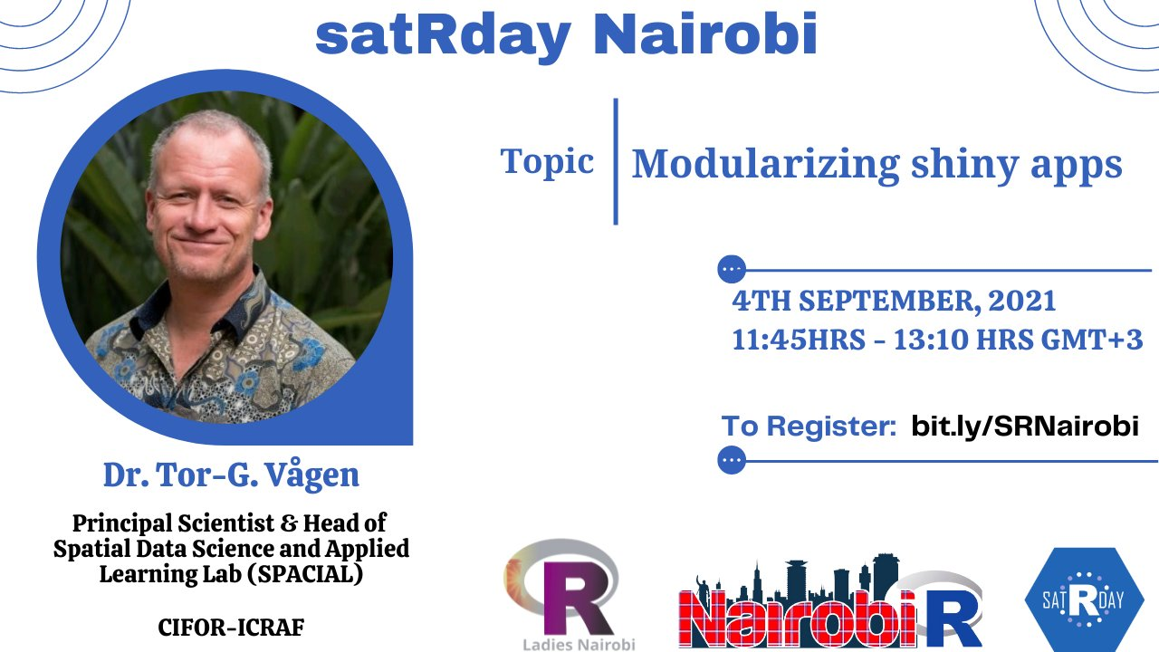
satRday Nairobi conference 2021
R-Ladies Nairobi
#NairobiR
Notes:
Additionally, in collaboration with NairobiR we held the first satRday Nairobi conference 2021.
All our recordings and learning resources are publicly available.

Slide 15

So 2022…
Focused on talks
Bimonthly meetups
Our first #Rstats Twitter space
Take a break
More collaborations

Slide 16
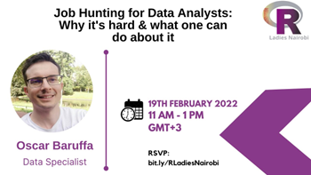
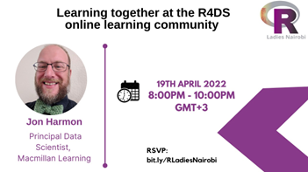
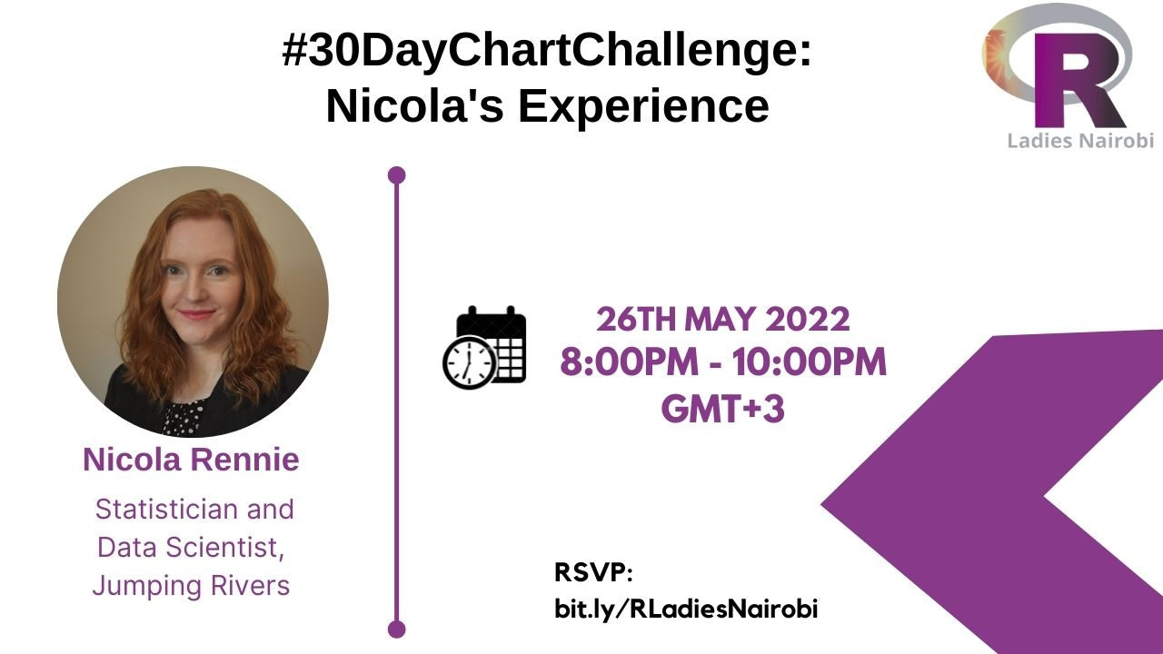

So 2022…

Slide 17
Challenges faced
Planning successful events can be exhausting
Attendance rate is still low

Slide 18
What has kept us strong …
Respect
Remembering the why
Organized
TEAM WORK
Rest
Communication

Slide 19

Email address: nairobi@rladies.org
LinkedIn: @R-Ladies Nairobi
Twitter: @RLadiesNairobi
Meetup: https://www.meetup.com/rladies-nairobi/
Notes:
That’s all from me … you can reach out via email, Twitter or our meetup page. Thanks

Slide 20

Questions?
Notes:
That’s all from me … you can reach out via email, Twitter or our meetup page. Thanks

